Slide 1
Songs Generator App
Under the Supervision of :
Dr. Nada Ghneim
Eng. Massa Baali
A Senior Project by:
Amjad Almrai | Aous Abdulhamid
1

Slide 2
Table of Contents
01
02
03
04
05
06
Introduction
Lyrics Generator
Music Generator
Voice Synthesis
Project
Application
Project Timeline
Difficulties & Future Vision
Used
Technologies
07
08
2

Slide 3
Introduction
01
3

Slide 4
Music has always been tied to technology.
Song = Music + Lyrics +Speech
The creation of songs, music, and speech is a significant aspect of human creativity.
Can we teach machines to convey their emotions and ideas through AI songs
4

Slide 5
Soul Composer : is an app that generate lyrics and music according to the user's selected mood (happy, sad, etc.),then generate voice based on the lyrics and music that our app developed.
5

Slide 6
Comparison
 | Boomy | My Lyrics Maker | Melobytes | Sound raw | Soul Composer
Lyrics Generator | ☓ | From Topic | According To Your Lyrics | ☓ | ✓
Music Generator | ✓ | ✓ | ✓ | ✓ | ✓
Voice Synthesis | Record Your Voice | ☓ | ✓ | ☓ | ✓
Mood Choice | ✓ | ☓ | ☓ | ✓ | ✓
Save As Play List | ☓ | ✓ | ☓ | ✓ | ✓
6

Slide 7
Project Pipeline
User Authentication
User selects mood or emotion
Lyrics will be inspired by emotions
Music will be produced according to emotions
The song can be added to the user's playlist.
Voice Synthesis will be created from the lyrics and music
7

Slide 8
Lyrics Generator
02
8

Slide 9
Structure
Model Objective: generate lyrics based on emotion
Dataset
Preprocessing
Architecture
Results
9

Slide 10
Data Set
We have collected all of the songs from allmusic.com.
Based on five emotions, five datasets
has 200 songs, one for each emotion.
10

Slide 11
Preprocessing Data
01
02
03
04
Tokenization
Lowercase Words
Remove Punctuation
Remove Duplicates
05
06
07
Sequences Of Token
Sequence Of Integers
11
Separate The Sequence to input and output

Slide 12
Architecture
Word[0]
Word[1]
Word[2]
Word[3]
Word[4]
Word[n]
Input Layer
Hidden Layer
Output Layer
One Embedding Layer + two LSTM layers + two Dense layers with Relu
SoftMax
Classification
12

Slide 13
HOW WILL THE MODEL DO IT?
4
Upon adding hyper parameters, lyrics is obtained.
The output of the LSTM was sent to two dense layers.
3
The output of the embedding layer is then taken by the two LSTM layers.
2
Word index and sequence length are entered into embedding layer.
1
13

Slide 14
Results
Hyperparameters :
Activation : Relu and softmax
Different epochs : for each five models
Batch size : 128
optimization algorithm : Adam
loss function : categorical crossentropy
After applying hyper parameters to our five models, we obtain varying degrees of accuracy (92–96%).
14

Slide 15
Music Generator
03
15

Slide 16
Structure
Model Objective : generate music depending on emotion from midi files
Dataset
Preprocessing
Architecture
Results
16

Slide 17
Data Set
Our dataset POP909 includes piano tunes stored in the MIDI (Musical Instrument Digital Interface) format
Using MuseScore3, we separate that dataset to five emotions.
Each dataset contains between 50 to 85 midi file
music21 (a toolkit for computer-aided musicology, MIT) These MIDI files data were extracted using a Python toolbox.
17

Slide 18
Preprocessing Data
All dataset will be transformed into music21 objects.
01
02
Extract chords from objects scores
Obtain notes and their duration.
03
04
Choose the C major key
Mapping chords and durations to integers
05
06
Create Sequence Of Integers for chords and durations
Construct train and target sequences for chords and durations
07
18

Slide 19
Architecture
Input Layer
Hidden Layer
Output Layer
Two Embedding Layer + two LSTM layers + one Dense layers with tanh Function
SoftMax
Classification
19

Slide 20
HOW WILL THE MODEL DO IT?
4
Upon adding hyper parameters, notes and durations are obtained.
Dense layer changing the output's dimension to 1
3
Then, the two LSTM layers take the concatenated versions of both inputs.
2
Notes and durations are entered into two embedding layers.
1
20

Slide 21
Results
Hyperparameters :
Activation : Tanh and softmax
Different epochs : for each five models
Batch size : 128
optimization algorithm : RMSprop
Learning rate :0.01
loss function : categorical crossentropy
After applying hyper parameters to our five models, we obtain varying degrees of accuracy (94–96%).
21

Slide 22
04
Voice
Synthesis
22

Slide 23
Structure
Model's objective : is to generate voice from midi files and lyrics.
Hidden Markov Models (HMMs) were used to create a singing voice synthesizer.
H o w ?
23

Slide 24
Preprocessing the midi and the lyrics
01
02
Check The Midi File if Contains one Channel
Verify that the wording matches the amount of notes
03
04
Define the Voice's Speak Rate
05
Define the voice's tempo
06
Pass Mid, Lyrics, Speak Rate, and Tempo using Mid2Voice Models.
07
Call Voice Render in order to hear the voice
24

Slide 25
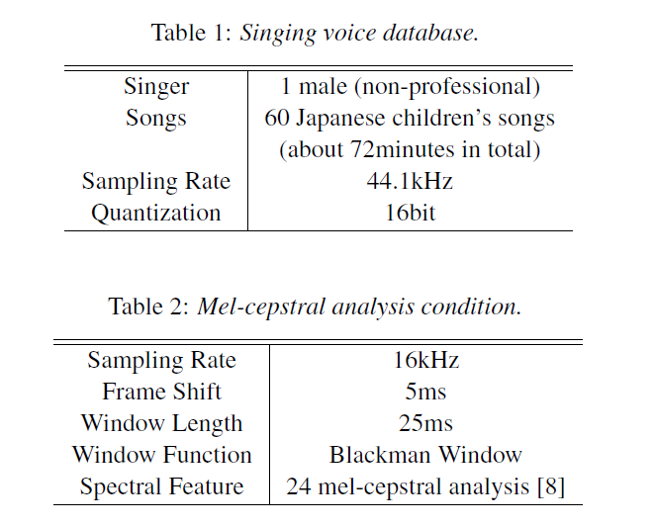
Data Set
25

Slide 26
Voice Synthesizer
In the training part, first we extract spectral and excitation parameters from a singing voice dataset and then they are modeled by context-dependent HMMs.
Context-dependent state duration models and time-lag models are also estimated.
In the synthesis part, first musical score to be synthesized is converted to a context-dependent label sequence.
26

Slide 27
Voice Synthesizer
according to the label sequence, a song HMM is constructed by concatenating the context-dependent HMMs.
spectral and excitation parameters are generated by HMM
Finally, a speech waveform is synthesized directly from the generated spectral and excitation parameters using Mel Log Spectrum Approximation
27

Slide 28
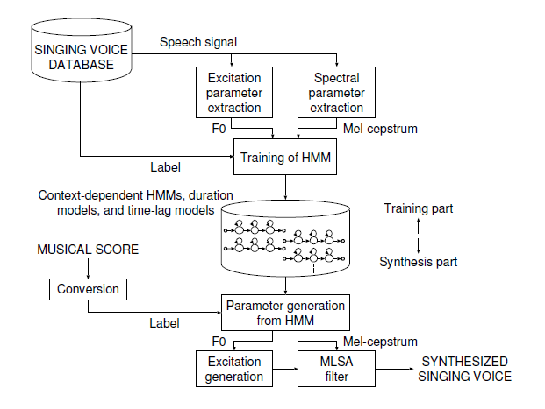
Voice Synthesizer
28

Slide 29
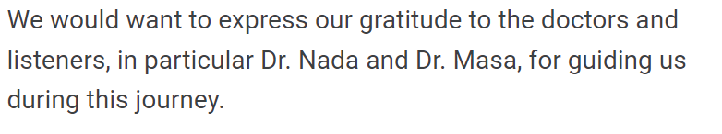
Voice Synthesizer Example
29

Slide 30
Project Application
05
How We Do That ?
30

Slide 31
User selects lyrics and music emotion, and API is called.
When an API detects an emotion, it sends it to a model, which then creates music and lyrics.
Generated music and lyrics are sent to the voice model. to generate a voice
Send music , lyrics and voice to the application, the user can now play it
31

Slide 32

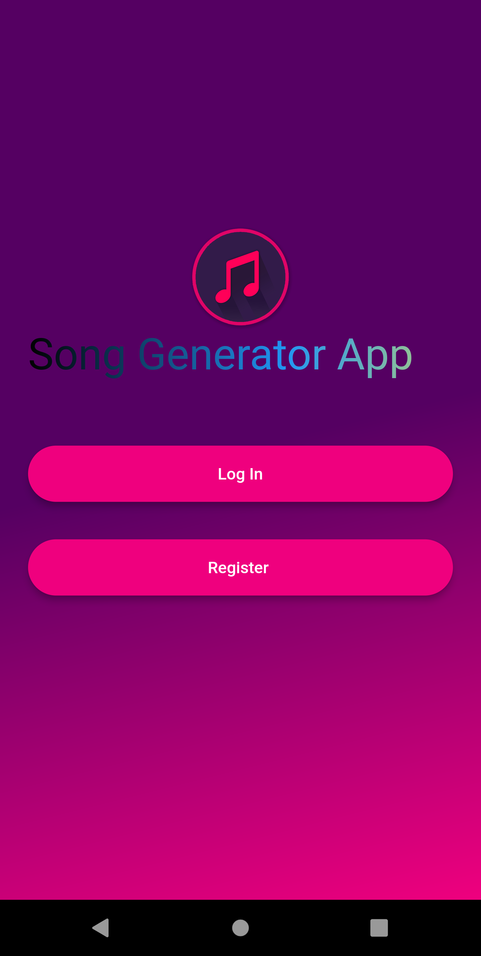
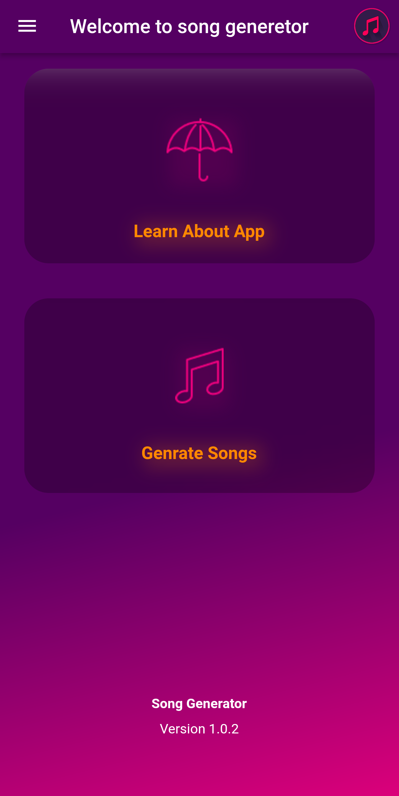
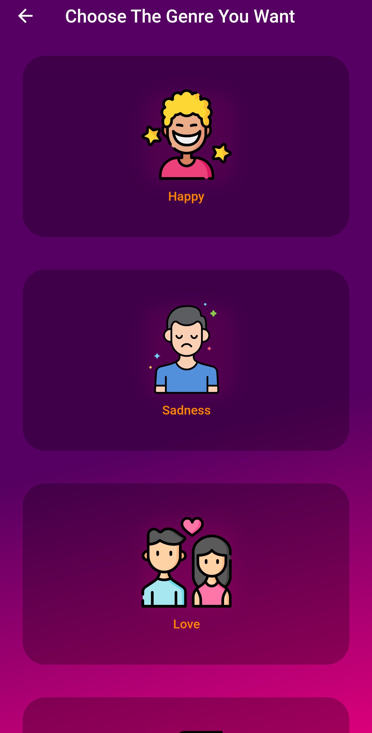
1
2
3
32

Slide 33
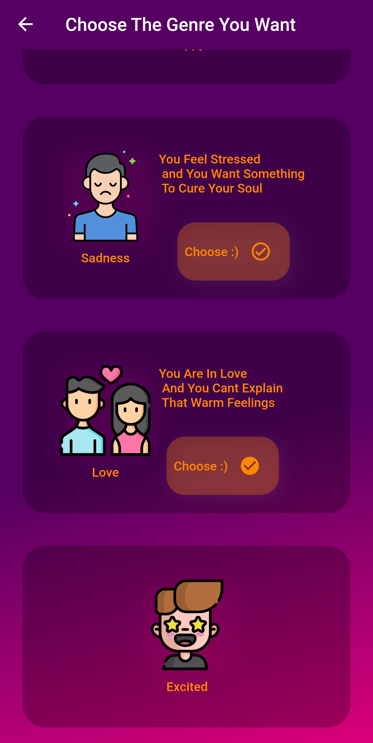
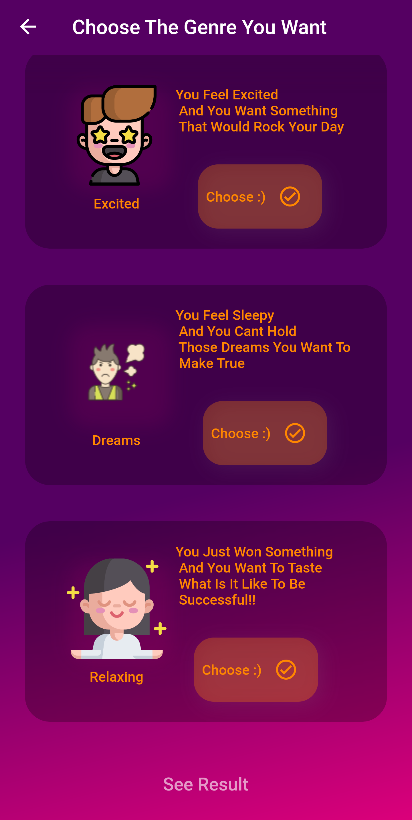
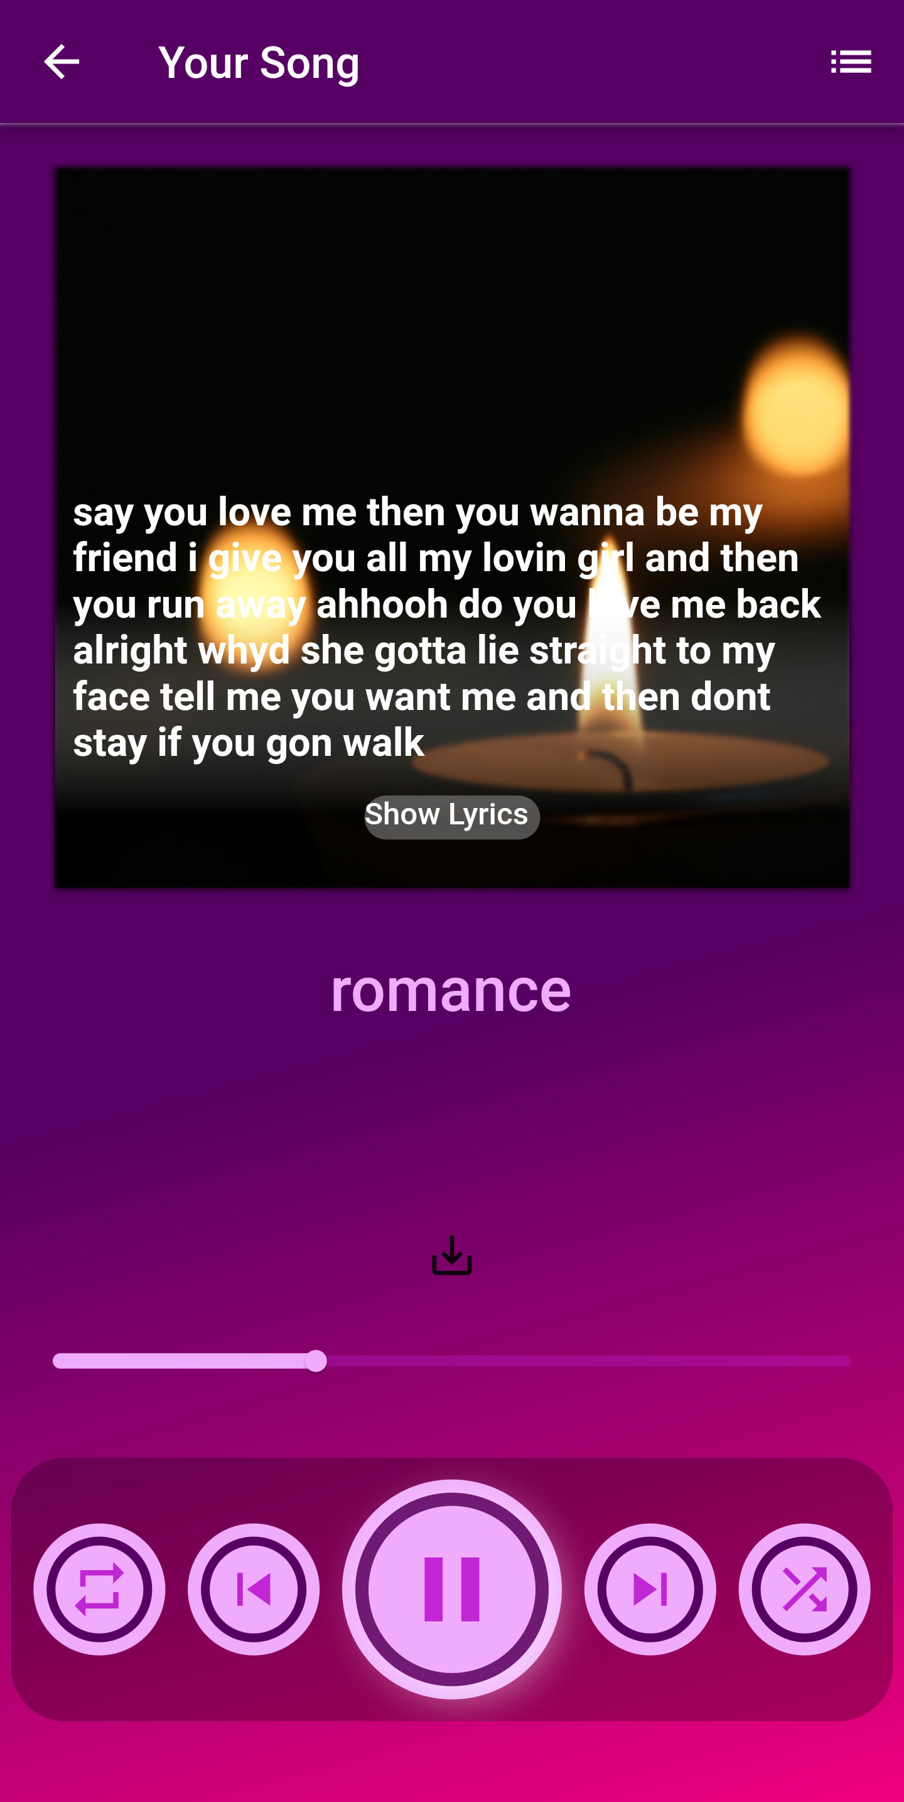
4
5
6
33

Slide 34
Project Timeline
06
34

Slide 35
WEEK 1-3
WEEK 3-7
WEEK 7-10
Building
Lyrics
Building Music
Voice
Synthesis
35

Slide 36
WEEK 10-12
WEEK 12-14
WEEK 14-17
System Analysis
Implementation
Testing and Report
36

Slide 37
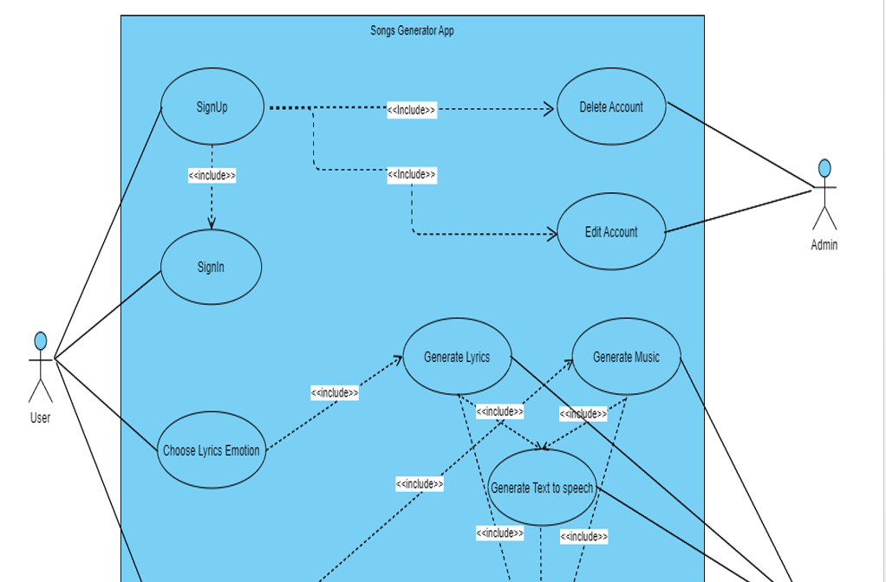
Use case Diagram
37

Slide 38
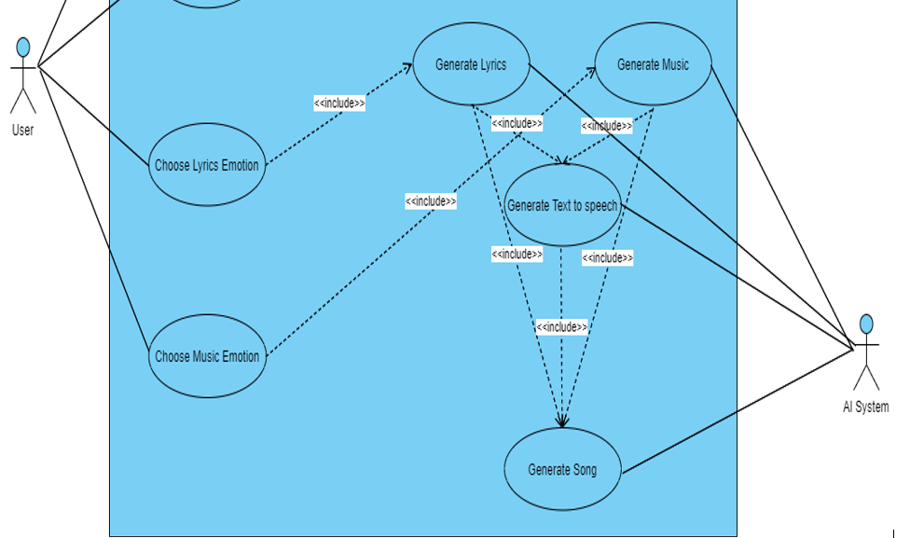
38

Slide 39
DIFFICULTIES & FUTURE VISION
07
39

Slide 40
Training
Linking
Dataset
Understand Music
40
Music Sync

Slide 41
Song in another language
Voicing for particular artists
lyric video for the song
Various instrument music
41

Slide 42
Used Technologies
08
42

Slide 43






Flutter
Application
Building
Model
Developing
43

Slide 44
THANKS!
For your
time, attention, everything!
44

